Slide 1

ADVENTURE WORKS (EXCEL)
Jahnavi Adapa
Rohit Rajesh Chavan
Alsha Kumari
Prerana Shubham Alande
Somya Ranjan Behera
Sumit Kumar Nayak
Jayanthy Prahashit

Slide 2
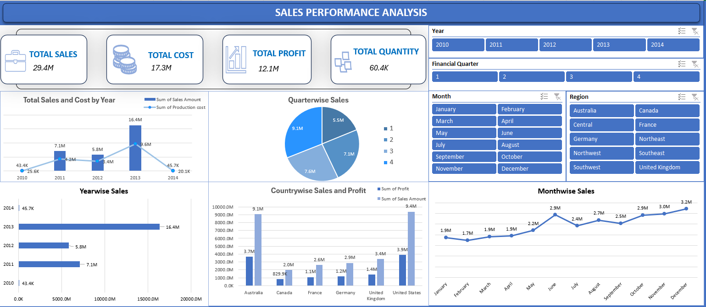
DASHBOARD 1

Slide 3
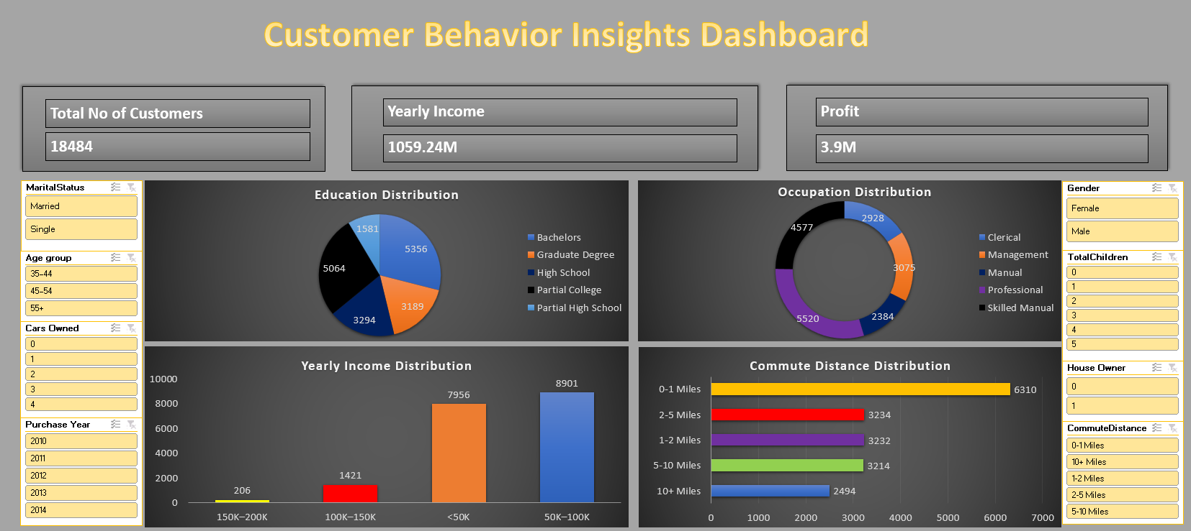
DASHBOARD 2

Slide 4
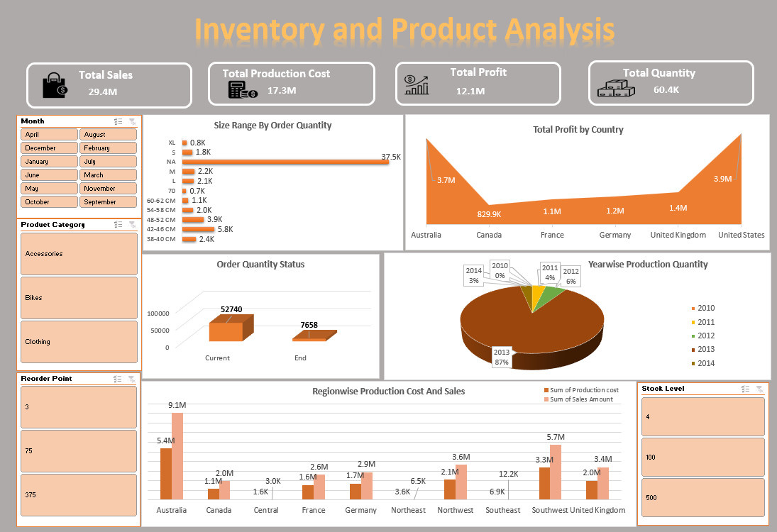
DASHBOARD 3

Slide 5
THANK YOU

